Slide 1
Nonappropriated Fund Standard General Ledger (NAFSGL) Update Version 2.0

Slide 2
NAFSGL Project Background
The FMR volume 13 chapter 2 required all NAFIs (except the exchanges) implement the NAF Standard General Ledger (NAFSGL) provided in the FMR by January 31, 2015
NAF Accounting RIE of the Task Force on Common Services identified compatibility concerns with the NAFSGL in the FMR
Service representatives believed FMR NAFSGL accounts did not reflect the proper accounts needed to record MWR transactions
OSD and Mil Depts agreed to create a revised NAFSGL that all Services would adopt.
Formed NAF Accounting Working Group, held week-long offsite Jan 2014, monthly meetings since to develop NAFSGL and common account framework
Initial common account framework (NAFSGL 1.0) was approved in June 30, 2015 and became effective October 1, 2016.
Updated common account framework (NAFSGL 2.0) was signed by Mrs. Johnston (DASD(MC&FP)) on January 15, 2019.

Slide 3
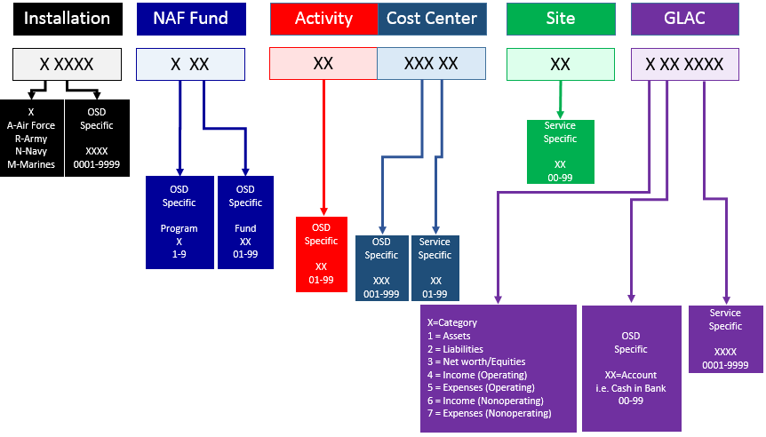
Critical Components of Standard Account Code Structure
Installation
NAFI
Program
GLAC

Slide 4
NAFSGL updates to version 2.0
Activity Codes Update
Installation List Update
General Ledger Activity Codes (GLAC) Update
Notes:
Recommend adding words in header

Slide 5
Activity Codes Update
Added Activity Codes to NAFSG to create three way match between:
The NAFSGL
The OP-34 “Quality of Life” budget exhibit
DoDI 1015.10, Military MWR Programs
Category A MWR Activities Added to NAFSGL
Title | Code
Armed Forces Entertainment | 41
Sports and Athletics (Self-Directed, Unit Level, Intramural) | 42

Slide 6
Activity Codes Update
Category B MWR Activities Added to NAFSGL
Title | Code
Equestrian Programs - Category B | 21
Cable/Community Television | 43
Outdoor Recreation Equipment Checkout | 44
Special Interests – Amateur Radio | 45
Sports Programs Above Intramural Level | 46
CD1 Child Development Centers (CDCs) | 47
CD2 Family Child Care (FCC) | 48
CD3 Supplemental Programs/Resource & Referral/Other (PVV) | 49
CD4 School Age Care (SAC) | 56
Category C MWR Activities Added to NAFSGL
Title | Code
Joint Service Facilities/AFRCs | 57
Horseback Riding Program and Stables - Category C | 58
Equipment Rental | 59

Slide 7
Installation List Update
With assistance from all Military Services, updated the NAFSGL installation list to:
Spell out acronyms
Remove closed/redundant installations
Ensure that Joint Bases are aligned with the “Supporting” Service only and removed from the “Supported” Service so there is no redundancy or confusion.
Example: Joint Base Anacostia Bolling (JBAB) installation code aligned to Navy (e.g. Supporting). There is no longer a separate Joint Base Bolling installation code aligned to Air Force (e.g. Supported)

Slide 8
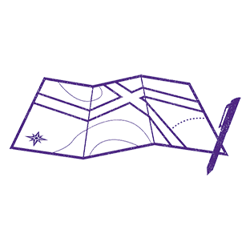
General Ledger Account Codes (GLAC) Update
The Military Services requested a re-alignment of the GLACs to group them by the following like categories:
Current Liabilities (200-239):
(200-204): General Accounts Payable
(205-219): Employee related liabilities
(220-229): Transfers & Financial Activities
(230-234): Unearned Income Activities
(235-239): Miscellaneous
Operating Expenses (500-599):
(500-504): Activities associated with COGS
(505-519): Personnel
(520-534): Facility and Equipment
(535-544): Internal Funds Transfer
(545-599): Miscellaneous
Non-Operating Income (600-699):
(600-609): Interest, Rebates, and Fees
(610-619): Personnel
(620-629): External Income
(630-639): Realized Gains & Losses
(640-699): Miscellaneous

